Slide 1
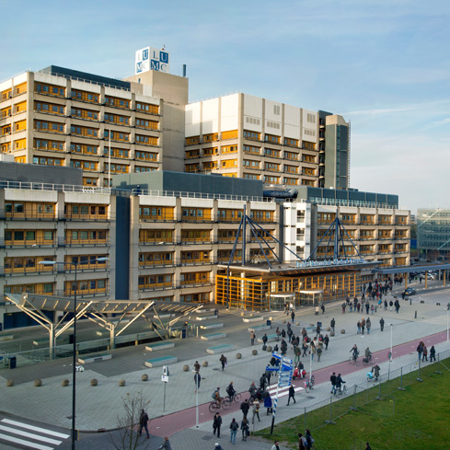
How do you, scientist, interpret my results?
Prof. dr. Anske van der Bom
Department of Clinical Epidemiology
& Health Campus The Hague

Slide 2

What you ignore
Notes:
We need others to see the truth

Slide 3
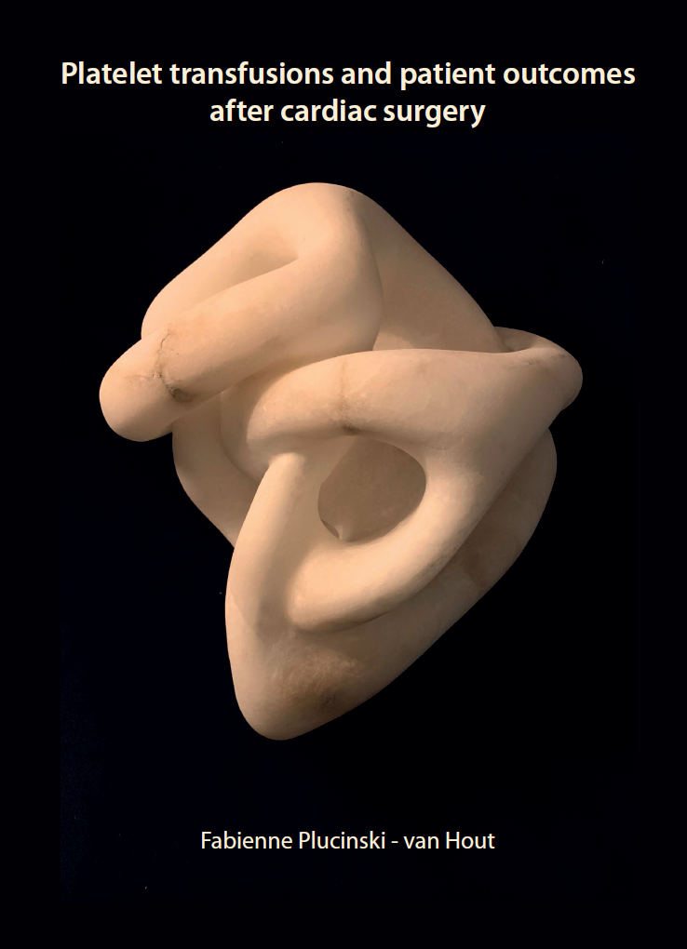
Platelet transfusion & cardiac surgery
Fabienne Plucinski-van Hout, ophthalmology, EUR
Meindert Palmen, cardiologist, LUMC
Jean-Louis Kerkhoffs, hematologist, Haga & Sanquin
Peter Rosseel, anesthetist, Amphia
Rutger Middelburg, epidemiologist, Health Campus
Leo van de Watering, transfusion-physician, Sanquin
Camila Caram-Deelder, epidemiologist, LUMC & Sq
Aad Pors, data manager Sanquin

Slide 4
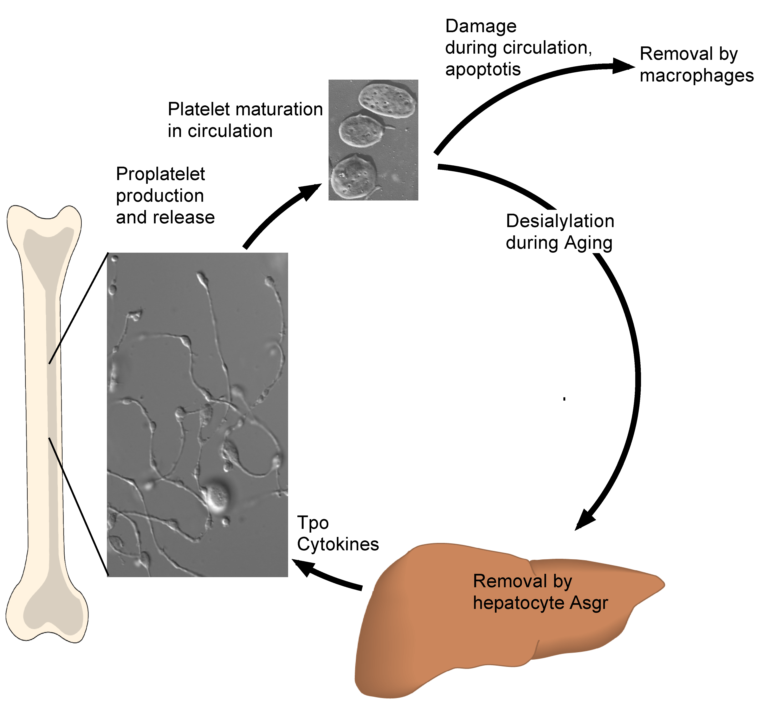
Platelets, cardiac surgery & transfusion
Platelet life span 8-9 days
Heart disease
Antiplatelet drugs
Cardiac surgery
Transfusion platelet concentrate
Notes:
the body must generate and clear platelets daily to maintain normal physiological blood platelet counts. Known platelet clearance mechanisms include antibody-mediated clearance by spleen macrophages, as in Immune Thrombocytopenia (ITP), and platelet consumption due to massive blood loss.

Slide 5
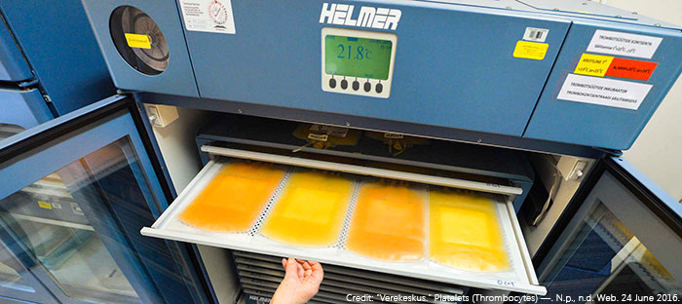
Platelet concentrate
Donor platelet concentrate in NL
5 donor buffy coat
storage medium
Temp 22 degrees C
5-7 days
bactAlert (contamination)
“platelet storage lesion”
Notes:
Opsommen storage lesions

Slide 6
Research question
What is the effect of longer storage of platelet concentrates on efficacy and safety of platelet transfusion in cardiac surgery patient?
Fresh platelets = 1-3 days
Old platelets = 4-7 days

Slide 7
Methods
Cohort: cardiac surgery patients transfused with pooled platelet concentrates
Routinely collected data from two hospitals from Jan 2005 to Dec 2017
Endpoints :
in-hospital mortality (both hospitals)
blood loss within 12 hours after surgery, reoperation for bleeding, stroke, myocardial infarction, infection, systemic inflammatory response syndrome, shock, and multiorgan failure (1 hospital)

Slide 8
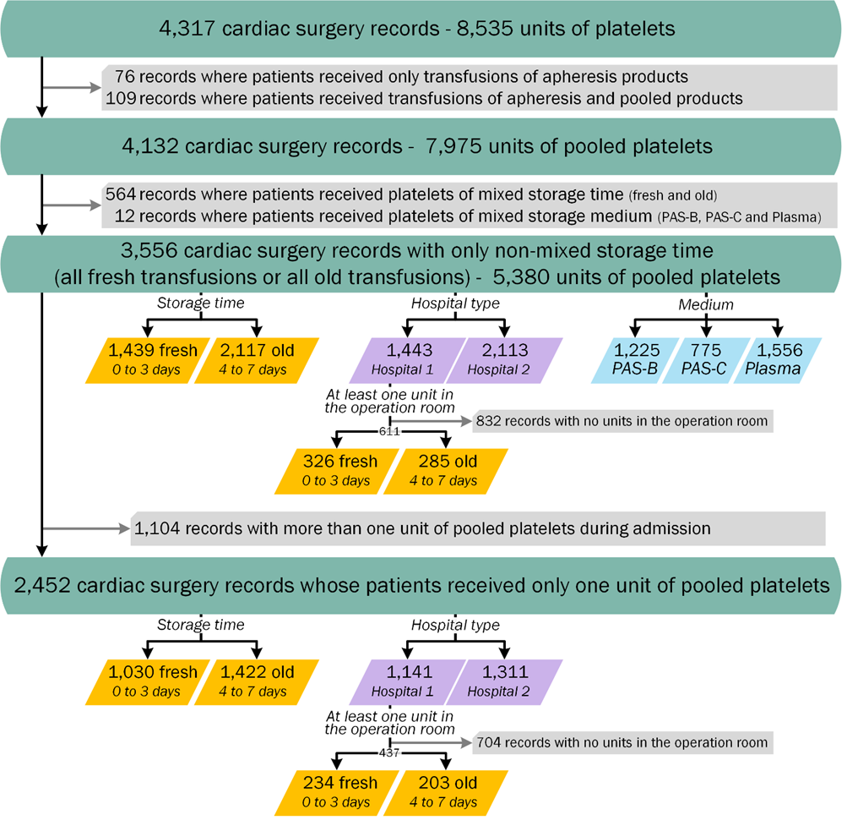
Study population 33,758 (24,769 hospital 1 and 8,989 hospital 2)
Notes:
33,758 (24,769 hospital 1 and 8,989 hospital 2)
Amphia 5,6 percent transfused
LUMC 23,5 percent transfused (more than 4 times Amphia’s frequency of transfusion)

Slide 9
Patient characteristics (percentage, mean or median)
 | Fresh n=1,439 | Old n=2,117
Age (years), mean (SD) | 67·5 (10·7) | 66·3 (11·6)
Female sex | 40·4 | 45·7
BMI, mean (SD) | 26·3 (4·0) | 26·5 (4·2)
Previous cardiac surgery | 13·8 | 15·5
Creatinine > 200 µmol/L | 3·0 | 4·0
Active endocarditis | 4·7 | 4·1
LV function good | 67·0 | 70·1
Recent myocardial infarction | 19·2 | 15·8
Emergency surgery | 17·4 | 18·2
Isolated CABG | 42·7 | 36·8
EuroSCORE I†, median (IQR) | 7·9 (3·4 - 18·0) | 7·5 (3·3 - 16·5)
Number of platelet transfusions, median (IQR) | 1 (1 - 2) | 1 (1 - 2)
Number of RBC transfusions, median (IQR) | 3 (1 - 6) | 3 (1 - 6)

Slide 10
In-hospital mortality
 | Number of deaths/ number of patients (% deaths) |  | OR (95% CI) of old vs fresh platelets
 | Fresh | Old | Crude | Corrected*
Overall | 109/1,439 (7·6) | 212/2,117 (10·0) | 1·36 (1·01 to 1·73) | 1·47 (1·13 to 1·91)
Storage fluid
PAS-B | 64/711 (9·0) | 65/514 (12·7) | 1·46 (1·02 to 2·11) | 1·49 (1·00 to 2·21)
PAS-C | 19/230 (8·3) | 59/545 (10·8) | 1·35 (0·78 to 2·32) | 1·36 (0·73 to 2·52)
Plasma | 26/498 (5·2) | 88/1,058 (8·3) | 1·65 (1·05 to 2·59) | 1·88 (1·16 to 3·03)
Hospital
Hospital 1 | 73/777 (9·4) | 85/666 (12·8) | 1·41 (1·01 to 1·97) | 1·41 (0·99 to 2·02)
Hospital 2 | 36/662 (5·4) | 127/1,451 (8·8) | 1·67 (1·14 to 2·44) | 1·72 (1·15 to 2·59)
Only one concentrate
Overall | 67/1,030 (6·5) | 104/1,422 (7·3) | 1·13 (0·83 to 1·56) | 1·24 (0·88 to 1·74)
Hospital 1 | 48/616 (7·8) | 53/525 (10·1) | 1·33 (0·88 to 2·00) | 1·26 (0·82 to 1·95)
Hospital 2 | 19/414 (4·6) | 51/897 (5·7) | 1·25 (0·73 to 2·15) | 1·31 (0·74 to 2·31)

Slide 11
In-hospital mortality
 | Number of deaths/ number of patients (% deaths) |  | OR (95% CI) of old vs fresh platelets
 | Fresh | Old | Crude | Corrected*
Overall | 109/1,439 (7·6) | 212/2,117 (10·0) | 1·36 (1·01 to 1·73) | 1·47 (1·13 to 1·91)
Storage fluid
PAS-B | 64/711 (9·0) | 65/514 (12·7) | 1·46 (1·02 to 2·11) | 1·49 (1·00 to 2·21)
PAS-C | 19/230 (8·3) | 59/545 (10·8) | 1·35 (0·78 to 2·32) | 1·36 (0·73 to 2·52)
Plasma | 26/498 (5·2) | 88/1,058 (8·3) | 1·65 (1·05 to 2·59) | 1·88 (1·16 to 3·03)
Hospital
Hospital 1 | 73/777 (9·4) | 85/666 (12·8) | 1·41 (1·01 to 1·97) | 1·41 (0·99 to 2·02)
Hospital 2 | 36/662 (5·4) | 127/1,451 (8·8) | 1·67 (1·14 to 2·44) | 1·72 (1·15 to 2·59)
Only one concentrate
Overall | 67/1,030 (6·5) | 104/1,422 (7·3) | 1·13 (0·83 to 1·56) | 1·24 (0·88 to 1·74)
Hospital 1 | 48/616 (7·8) | 53/525 (10·1) | 1·33 (0·88 to 2·00) | 1·26 (0·82 to 1·95)
Hospital 2 | 19/414 (4·6) | 51/897 (5·7) | 1·25 (0·73 to 2·15) | 1·31 (0·74 to 2·31)

Slide 12
In-hospital mortality
 | Number of deaths/ number of patients (% deaths) |  | OR (95% CI) of old vs fresh platelets
 | Fresh | Old | Crude | Corrected*
Overall | 109/1,439 (7·6) | 212/2,117 (10·0) | 1·36 (1·01 to 1·73) | 1·47 (1·13 to 1·91)
Storage fluid
PAS-B | 64/711 (9·0) | 65/514 (12·7) | 1·46 (1·02 to 2·11) | 1·49 (1·00 to 2·21)
PAS-C | 19/230 (8·3) | 59/545 (10·8) | 1·35 (0·78 to 2·32) | 1·36 (0·73 to 2·52)
Plasma | 26/498 (5·2) | 88/1,058 (8·3) | 1·65 (1·05 to 2·59) | 1·88 (1·16 to 3·03)
Hospital
Hospital 1 | 73/777 (9·4) | 85/666 (12·8) | 1·41 (1·01 to 1·97) | 1·41 (0·99 to 2·02)
Hospital 2 | 36/662 (5·4) | 127/1,451 (8·8) | 1·67 (1·14 to 2·44) | 1·72 (1·15 to 2·59)
Only one unit
Overall | 67/1,030 (6·5) | 104/1,422 (7·3) | 1·13 (0·83 to 1·56) | 1·24 (0·88 to 1·74)
Hospital 1 | 48/616 (7·8) | 53/525 (10·1) | 1·33 (0·88 to 2·00) | 1·26 (0·82 to 1·95)
Hospital 2 | 19/414 (4·6) | 51/897 (5·7) | 1·25 (0·73 to 2·15) | 1·31 (0·74 to 2·31)

Slide 13
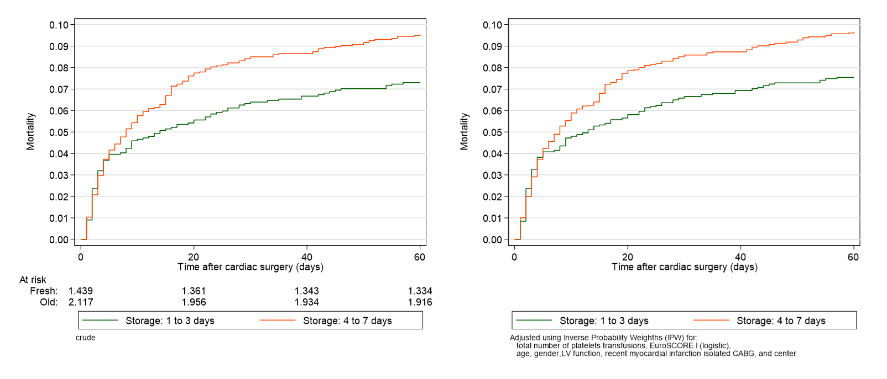
In-hospital mortality fresh and old PC

Slide 14
Study population

Slide 15
Other outcomes
 | Number (% ) |  | OR (95% CI) of old vs fresh platelets
 | Fresh | Old | Crude | Corrected*
Other outcomes
Blood loss ≥ 500 mL first 12 hours† | 173/326 (53·0) | 170/285 (60·0) | 1·31 (0·95 to 1·80) | 1·38 (0·98 to 1·92)
Blood loss ≥1000 mL first 12 hours† | 87/326 (26·7) | 102/285 (35·8) | 1·53 (1·08 to 2·16) | 1·74 (1·19 to 2·52)
Reoperation for bleeding† | 87/326 (26·7) | 99/285 (34·7) | 1·46 (1·03 to 2·07) | 1·62 (1·12 to 2·35)
Stroke† | 10/326 (3·1) | 8/285 (2·8) | 0·91 (0·35 to 2·34) | 0·90 (0·34 to 2·33)
Myocardial infarction† | 53/326 (16·3) | 36/285 (12·6) | 0·74 (0·47 to 1·18) | 0·87 (0·62 to 1·21)
Infection† | 86/326 (26·4) | 76/285 (26·7) | 1·01 (0·71 to 1·46) | 0·99 (0·68 to 1·44)
SIRS† | 67/326 (20·6) | 75/285 (26·3) | 1·38 (0·95 to 2·01) | 1·35 (0·92 to 1·99)
Shock | 85/326 (26·1) | 84/285 (29·5) | 1·18 (0·83 to 1·69) | 1·16 (0·79 to 1·69)
Multi organ failure | 50/326 (15·3) | 36/285 (12·6) | 0·80 (0·50 to 1·27) | 0·73 (0·45 to 1·19)
*for number of transfusions, EuroSCORE I, age, gender, left ventricular function, recent myocardial infarction isolated CABG, hospital

Slide 16
Interpretation
Confounding
Collider stratification (selection) bias
Measurement bias
Random error
Earlier findings
First in
Risk factors
Old vs Fresh
Death
Notes:
; the hazard ratio
for mortality according to increasing platelet storage age was 1.04 (95%CI 0·96-1·13) per day

Slide 17
Interpretation
Confounding
Collider stratification (selection) bias
Measurement bias
Random error
Earlier findings HR 1.04 (0.96-1.13) per day
First in
Risk factors
Old vs Fresh
Death
Notes:
; the hazard ratio
for mortality according to increasing platelet storage age was 1.04 (95%CI 0·96-1·13) per day

Slide 18
What you ignore
Notes:
We need others to see the truth

Slide 19
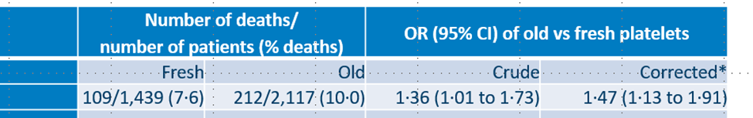
Interpretation / implication / PAR (13%)
Patient
please fresh for me
Blood bank
impossible
Anaesthetist
don’t know
Scientist
more research
You
?
Journal
retrospective
Notes:
How many deaths can be prevented? Total population n=3,556, number of deaths: 321 (9·0)
13 procent minder doden als iedereen nu fresh krijgt.

Slide 20
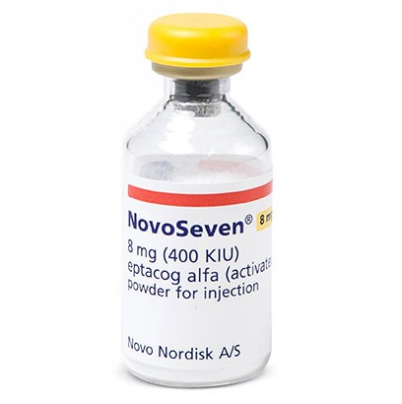
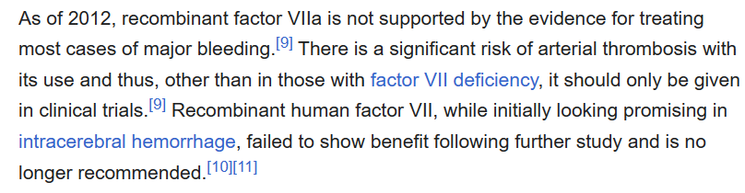
NovoNordisk
Recombinant factor VIIa
Activates factor X
Hemophilia with inhibitors
fVII deficiency
“NovoSeven® is used off-label to treat sPPH; we would like to make this treatment available on-label.”
Notes:
Main role in this story is for NovoNordisk

Slide 21
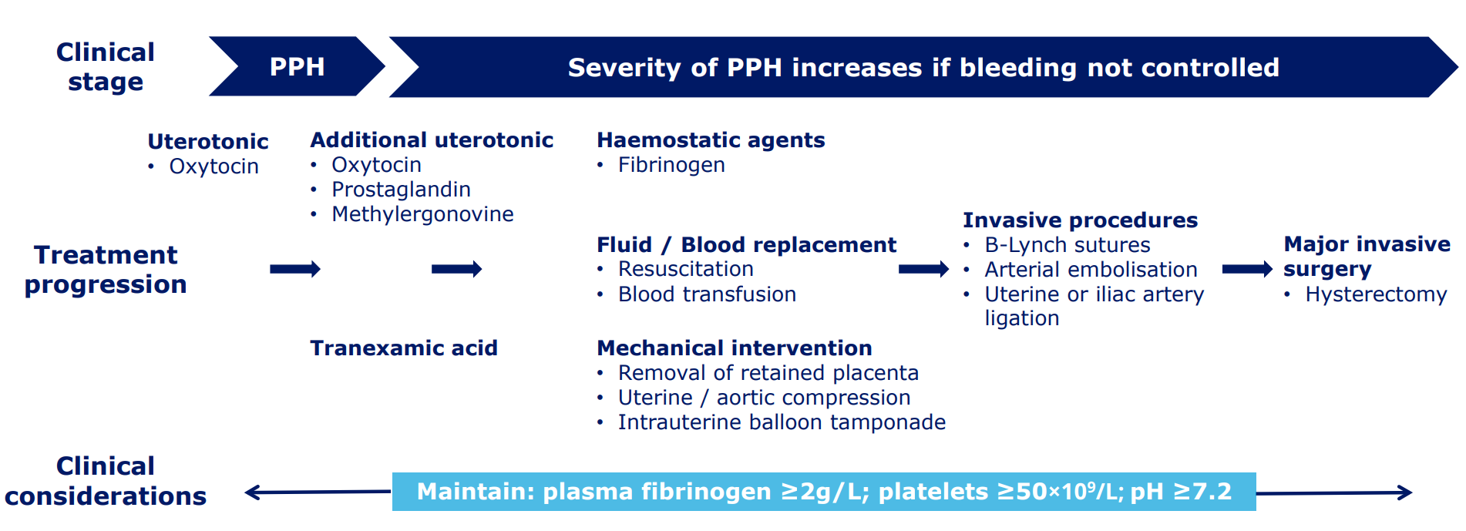
Postpartum hemorrhage (PPH)

Slide 22
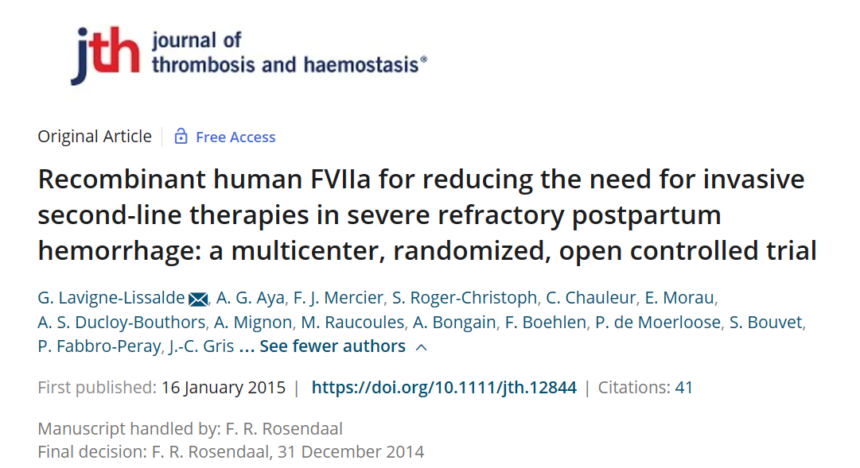

Slide 23
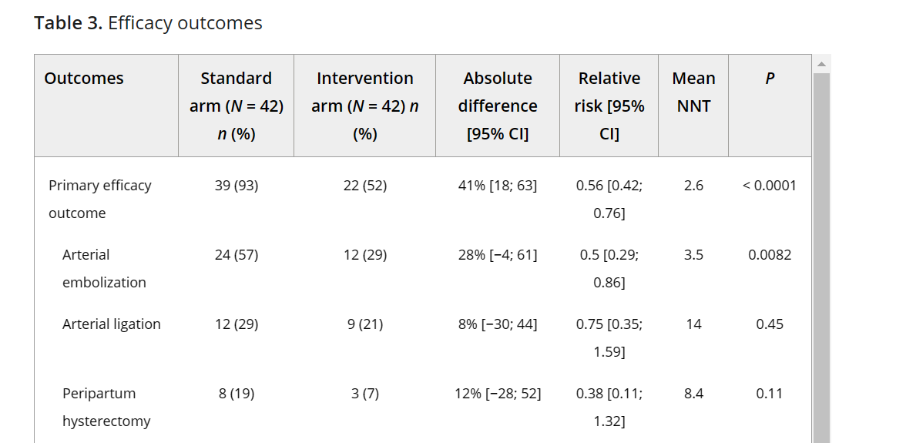

Slide 24
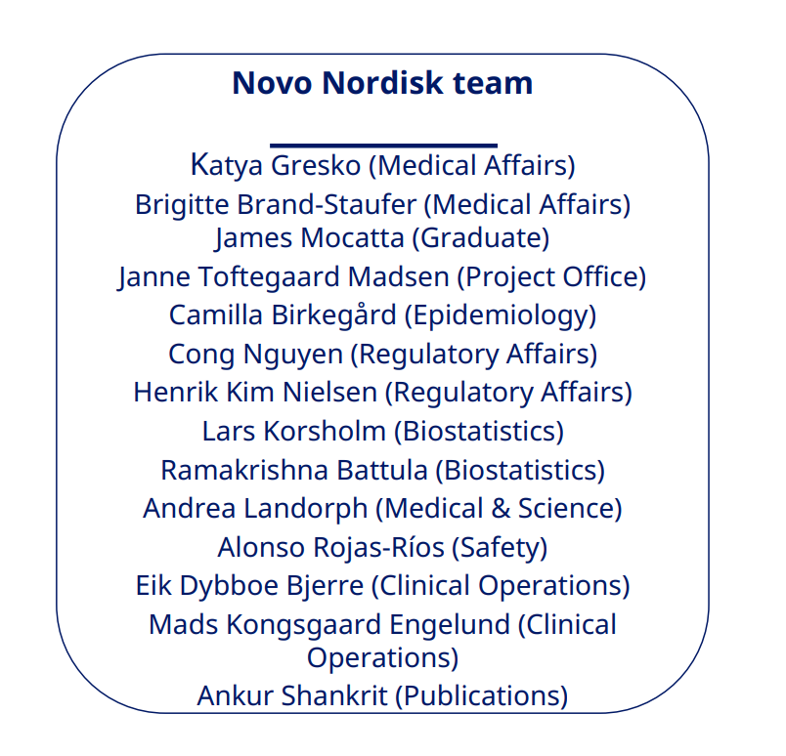
Scientific advice from EMA (April 2020)
A possible indication based on the RCT (pivotal study) supported by RWD
Agreed with primary efficacy endpoint (avoidance of invasive procedures)
Supported the timing of NovoSeven® after failure of uterotonics
Safety needs to be further supported by the RWD

Slide 25
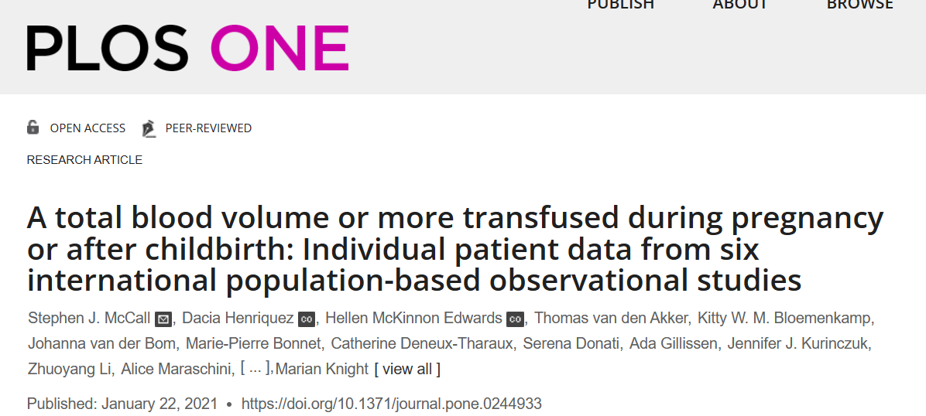

Slide 26
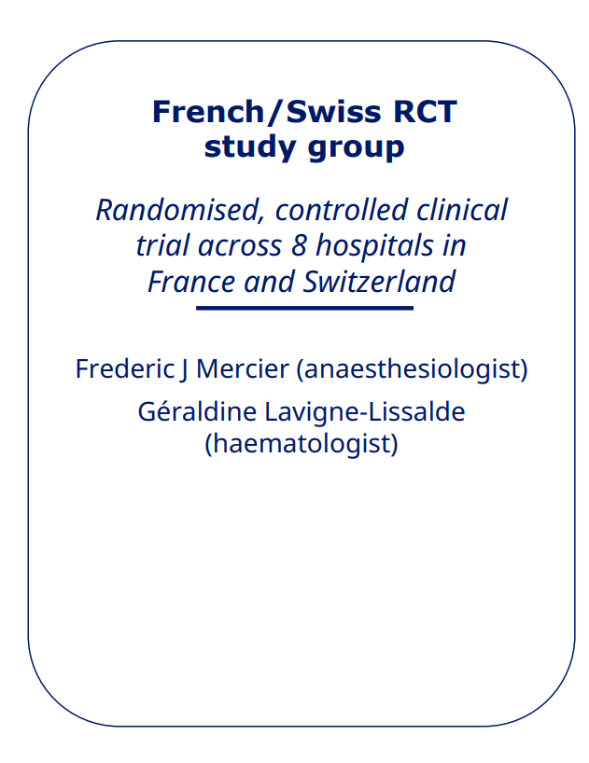
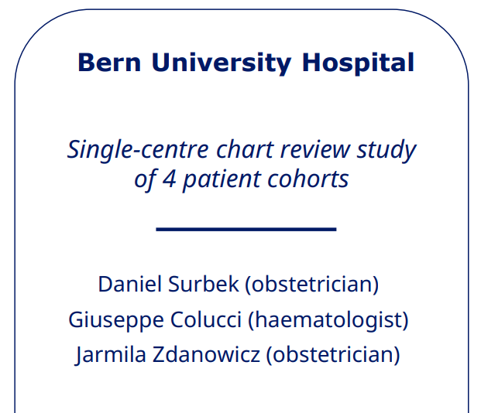
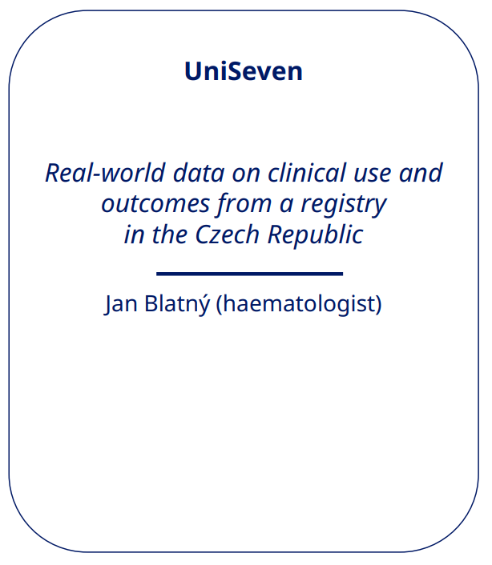
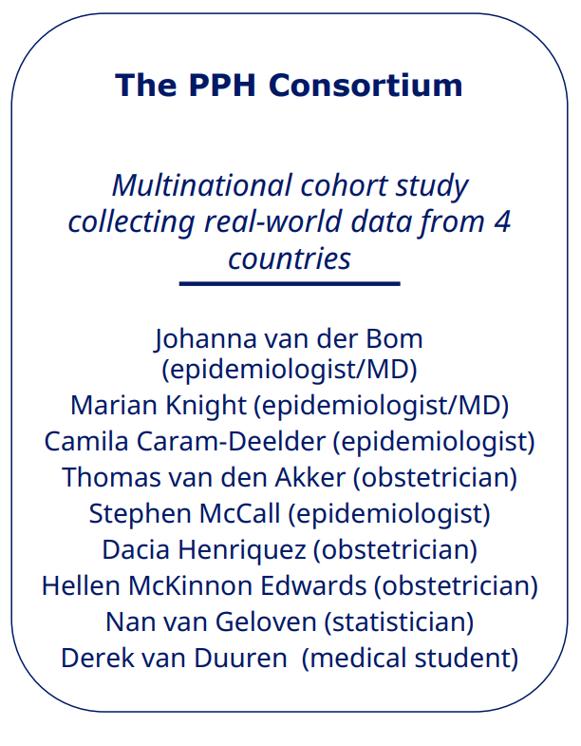
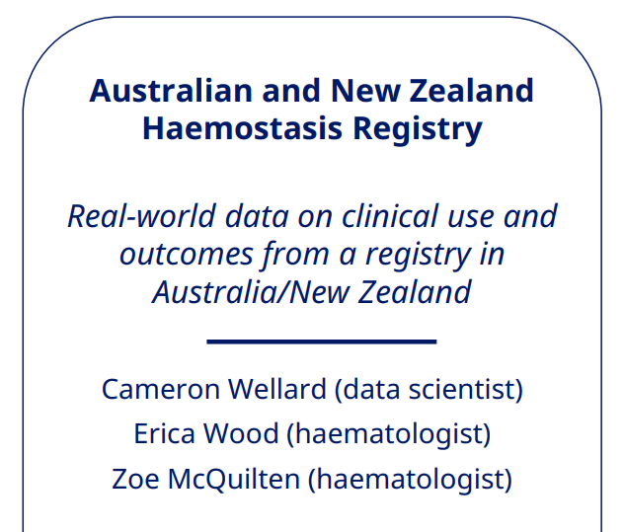
RCT supported by Real World Data

Slide 27
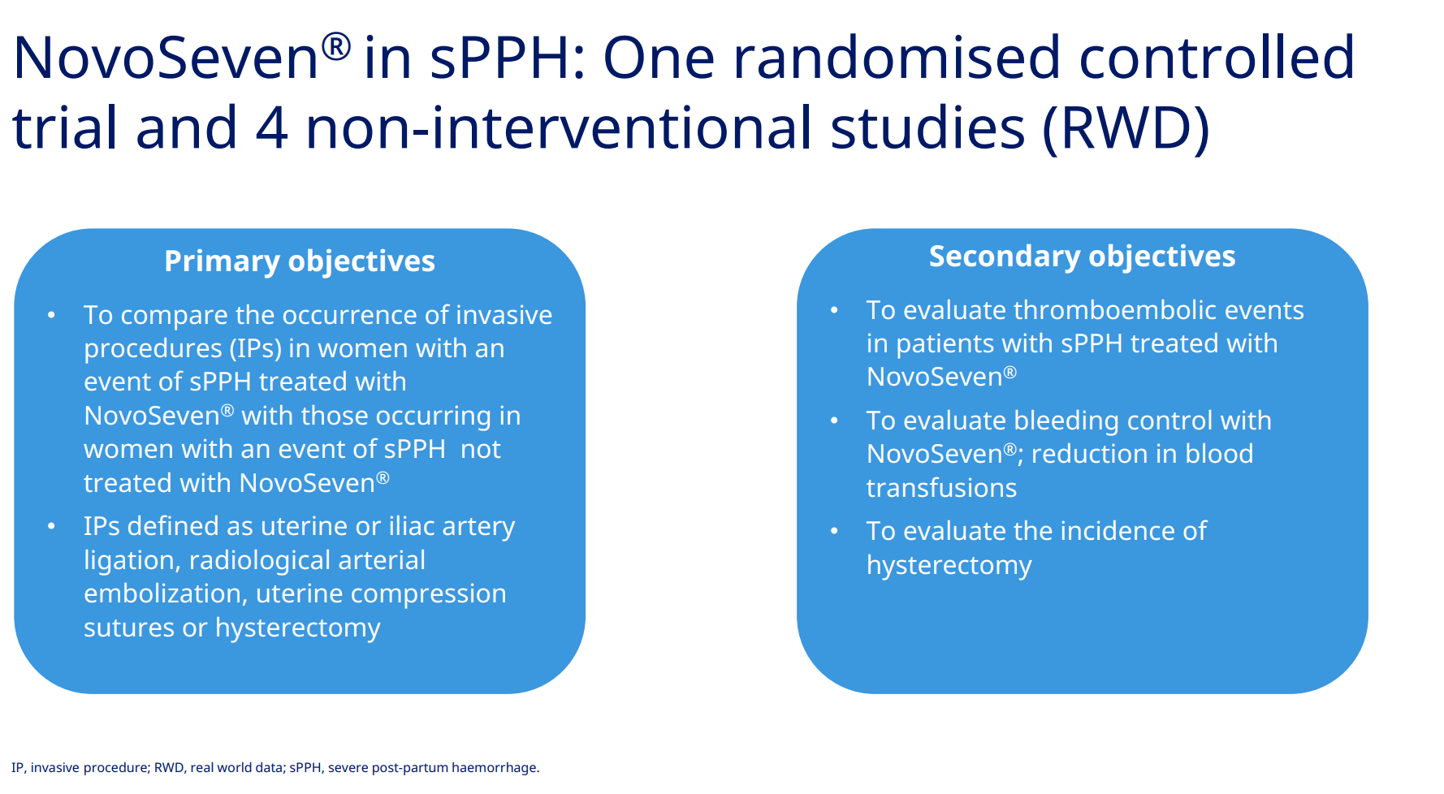

Slide 28
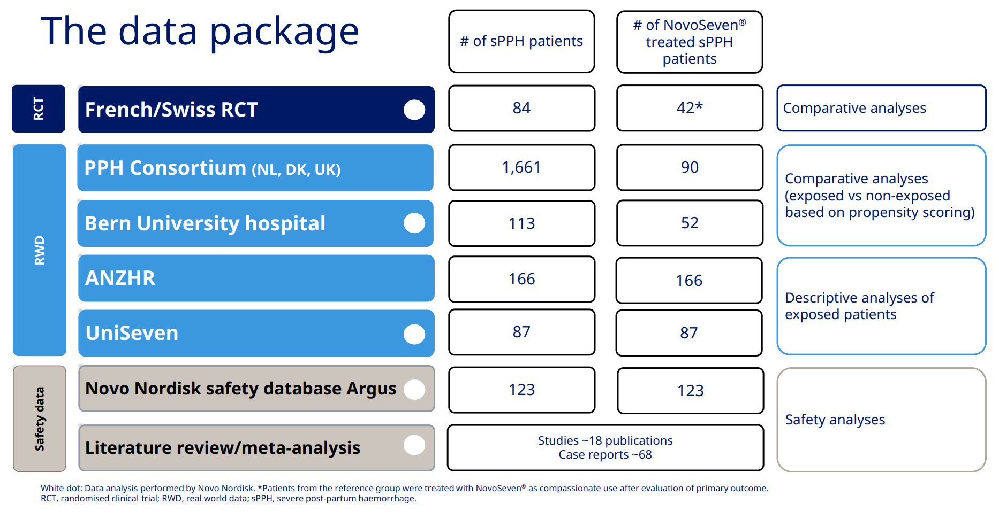

Slide 29
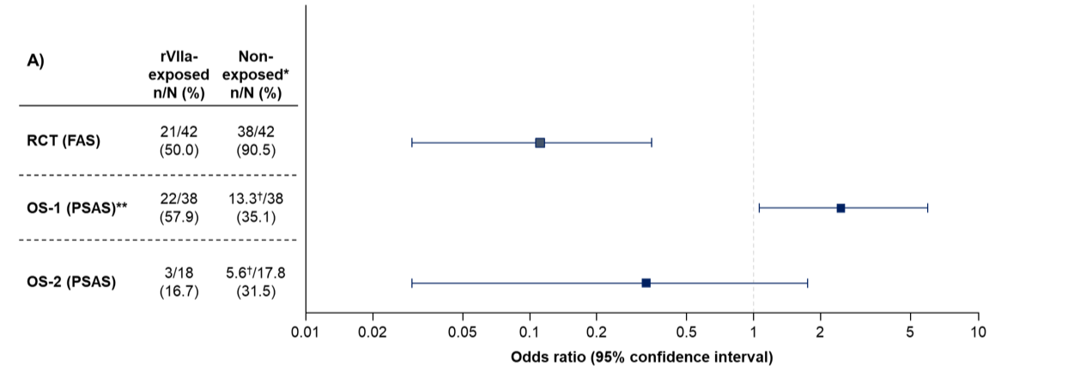
Result efficacy

Slide 30
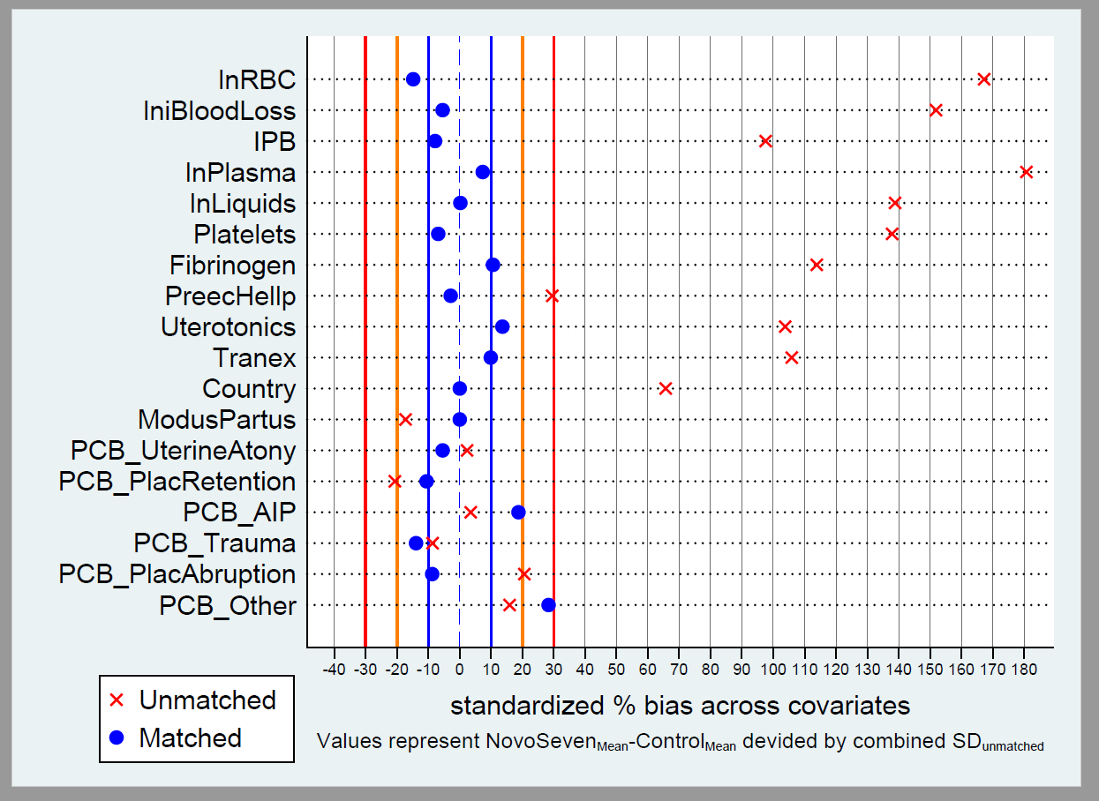
PSAS Propensity Score Analysis Set

Slide 31
Results efficacy
 | Randomised controlled trial (FAS) |  | Observational studies
 |  |  | OS-1 (PSAS)* |  | OS-2 (PSAS)
 | rFVIIa N=42 | Ref N=42 | rFVIIa N=38 | Weighted matched controls N=38** | rFVIIa N=18 | Weighted matched controls N=17·8**
At least one invasive procedure after rFVIIa administration† (primary endpoint), n (%) | 21 (50·0) | 38 (90·5) | 22 (57·9) | 13·3‡ (35·1) | 3 (16·7) | 5·6‡ (31·5)
Odds ratio (95% CI) | 0·11 (0·03–0·35) |  | 2·46 (1·06–5·99) |  | 0·33 (0·03–1·75)
p-value | ·· |  | 0·04 |  | 0·27
Women with hysterectomy, n (%) | 3 (7·1) | 8 (19·1) | 13 (34·2) | 7.8‡ (20·4) | 2 (11·1) | 3.1‡ (17·4)
Odds ratio (95% CI) | NP |  | 2·23 (0·83–6·06) |  | 0·52 (0·05–3·03)
p value | NP |  | 0·12 |  | 0·68
Relative risk reduction, % (95% CI) | 62·5 (−32–89) |  | NP |  | NP
p-value | 0·1944 |  | NP |  | NP

Slide 32
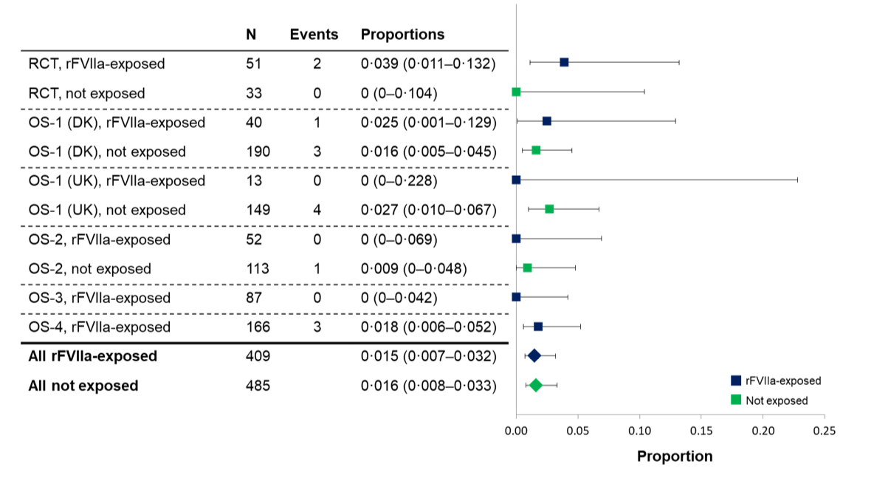
Result safety thrombo-embolic events

Slide 33
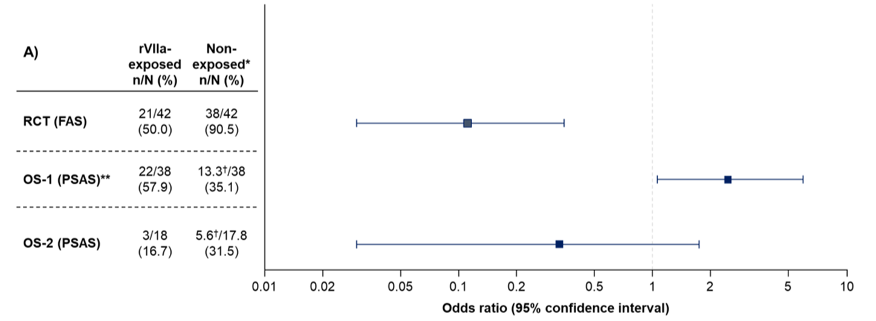
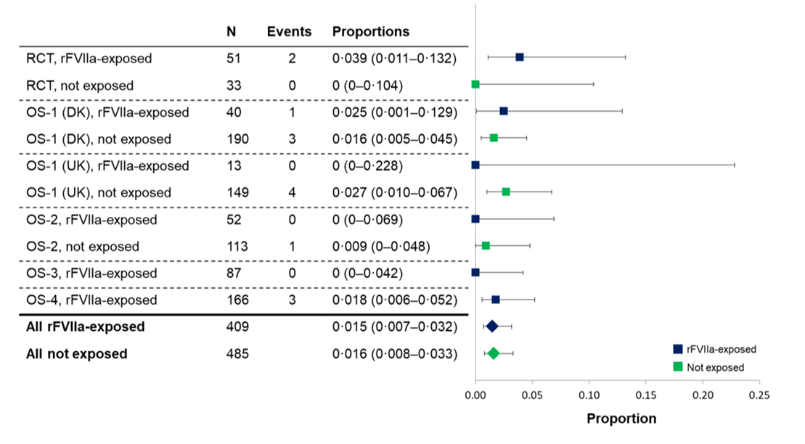
Interpretation
Confounding
Selection bias
Measurement bias
Random error
Other studies

Slide 34
Interpretation
F. Mercier
test for coagulopathy
M. Knight
proper RCT needed
D. Surbek
it works in my patients
NovoNordisk
rFVIIa efficacious and safe
EMA
?

Slide 35
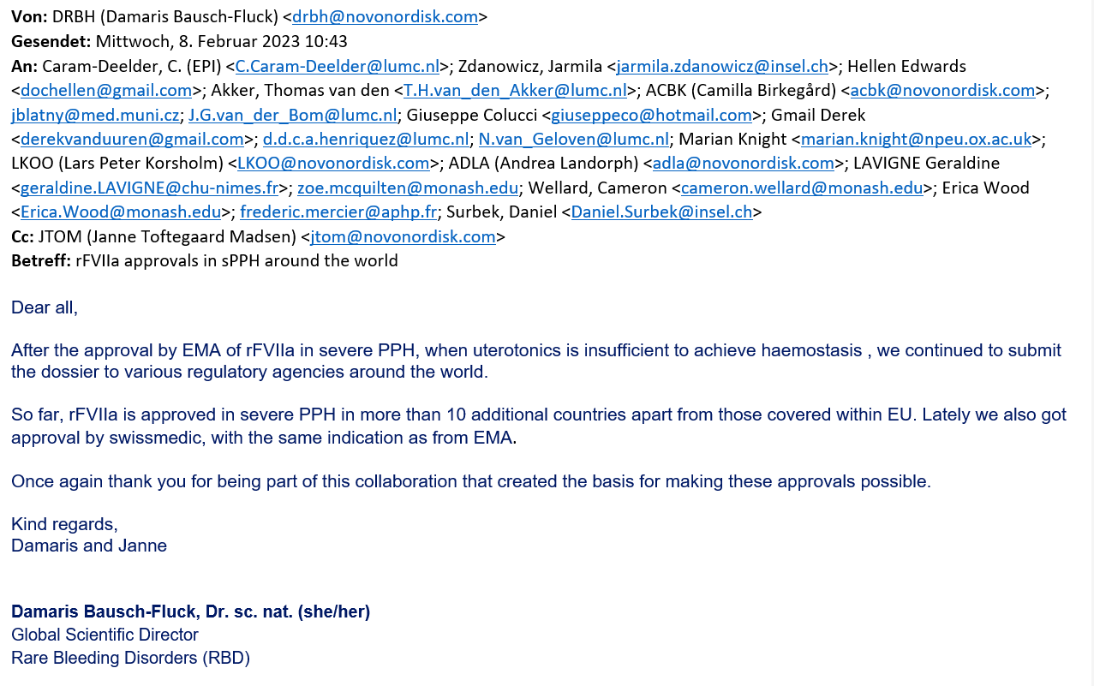
rFVIIa approvals in sPPH around the world

Slide 36
rFVIIa approvals in sPPH around the world

Slide 37
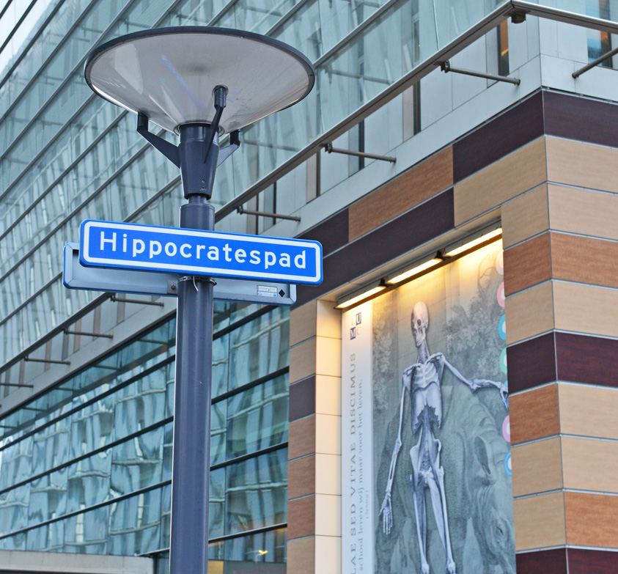
THANK YOU FOR YOUR ATTENTION

